Slide 1

Rock, Paper, Scissors: From Concept to Code
A classic game reimagined with modern technology. Implemented in Python.
We'll cover the game logic, coding, testing, documentation, and GitHub setup.
Sai Ethesh Kakumani
Sri Ram Reddy
tulasi ram reddy

Slide 2



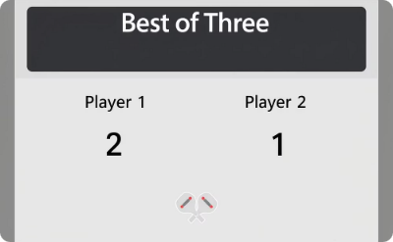
The Game: Rock, Paper, Scissors
Game Basics
Winning Rules
Tie Scenario
Game Format
Two players select rock, paper, or scissors simultaneously.
Rock beats scissors, scissors beat paper, paper beats rock.
Identical choices lead to a draw and round is replayed.
First to win two out of three rounds declares the winner.

Slide 3
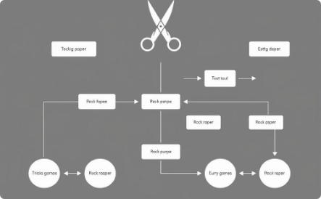

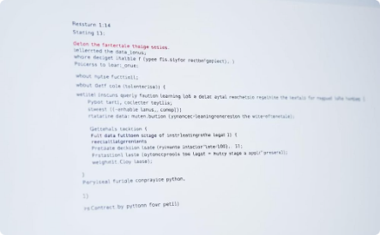
Designing the Game Flow
Game Flow Overview
Start the game, collect player choices, determine the winner, display results, and loop or end the game.
Player Choices
Each player inputs their choice: rock, paper, or scissors.
Key Functions
get_User_Choice(): Gets player input
determine_Winner(): Decides the round's winner
displayResult(): Shows winner or tie

Slide 4




Implementing the Game: Python Code (Part 1)
Setting Up Environment
Prepare Python interpreter and necessary IDE or terminal.
Receive Player Input
Use input() to get choices from the terminal for each player.
Sample Code Snippet
choice1 = input("Player 1, enter rock, paper, or scissors: ")
choice2 = input("Player 2, enter rock, paper, or scissors: ")

Slide 5
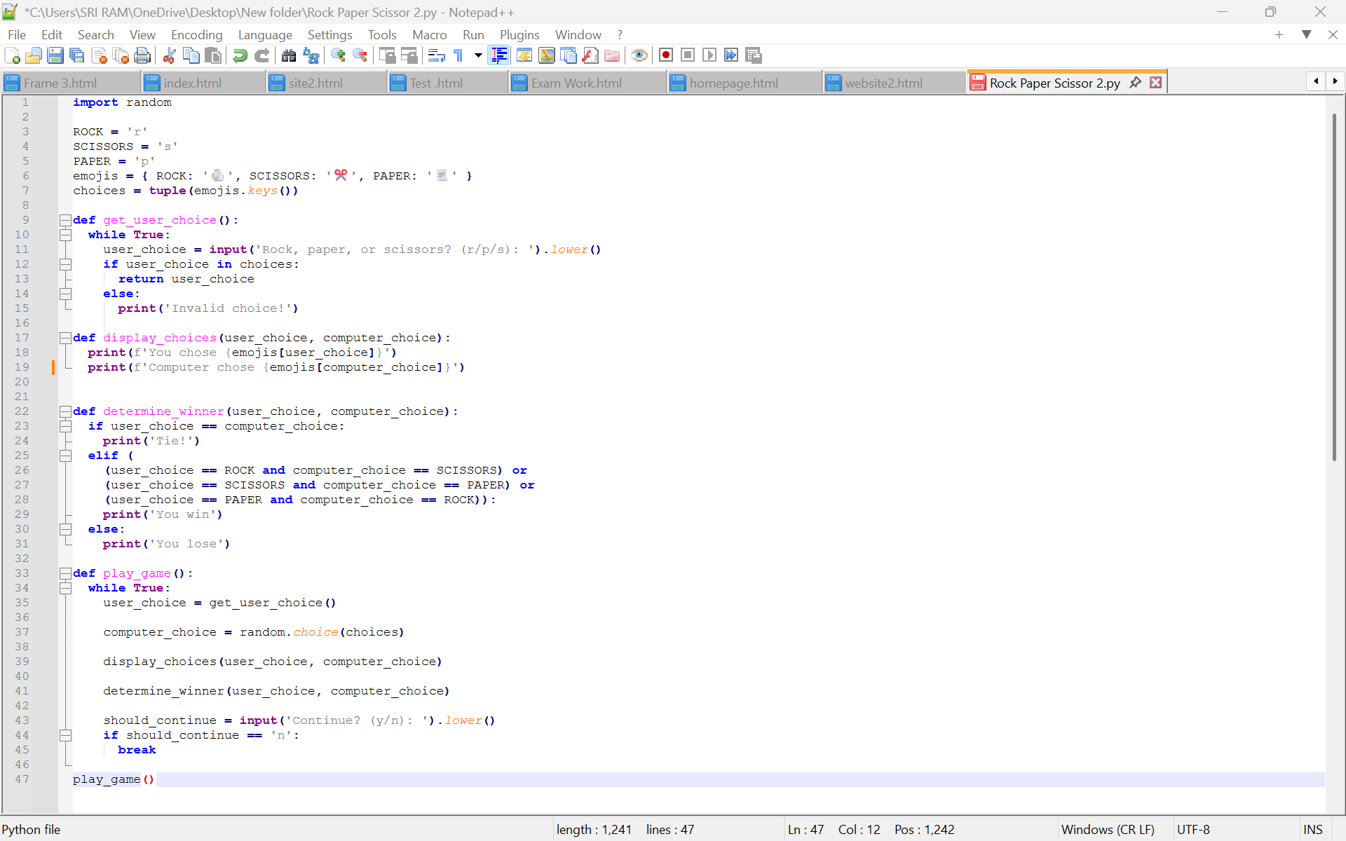

Slide 6



Thank You
Grateful for Your Attention
Appreciate Your Participation

